Slide 1
Project Planning
Software Project Management
Presenter
  Mrs. Sharon Mose
  Email: sharonmoseh@gmail.com
Notes:
Opening Slide

Slide 2
Project Planning
Software Project Management
Roadmap
Introduction
Project management plan
Developing project plans
Hierarchical planning process
Activity planning
Financial planning
Resource allocation
Notes:
Opening Slide

Slide 3
SPM
Project Planning
Introduction
Planning in general can be described as the function of selecting the enterprise objectives and establishing the policies, procedures, and programmes necessary for achieving them.
In a project environment, planning may be described as establishing a predetermined course of action within a forecasted environment.
Project planning facilitates later accomplishment.
Project planning is the first thing you do when undertaking a project.
Often project planning is ignored to rush in for the work.
The project manager is the key to successful project planning.
Planning is key to a successful project; why plan?
  To eliminate or reduce uncertainty
  To improve efficiency of the operation
  To obtain a better understanding of the objectives
  To guide project execution
  To provide a basis for monitoring and controlling work
  etc
Question: What could happen if there was no project planning?

Slide 4
SPM
Project Planning
Introduction
Project planning should be:
  Systematic (consistent with project phases and good formal project management)
  Flexible enough to handle unique activities (recall projects are unique)
  Iterative (things change and revisions are necessary)
  Performed throughout the project life cycle
  Disciplined (or enforced) through reviews and controls
  Capable of accepting multifunctional inputs
Successful total project planning therefore involves many dimensions e.g.
  Scope planning: regarding the work that needs to be done
  Activity planning: regarding scheduling activities related to the work
  Cost planning: regarding costing for performing the work
  Quality planning: regarding ensuring that product meets written specifications and intended use
  Procurement planning: regarding deciding what resource to procure to accomplish the work
  etc

Slide 5
SPM
Project Planning
Project management plan
A project management plan is sometimes referred to as: project plan or master plan or baseline plan.
A project management plan is a document used to coordinate all project planning documents and is especially helpful in guiding a project’s execution and control.
The project management plan includes all project planning documents, such as the ones created for the other specific knowledge areas e.g. scope planning, quality planning, cost planning, etc.
Project planning documents created in the other knowledge areas are therefore subsidiary parts of the overall project management plan.
The plan is a “living document”; there will be changes along the project life cycle (e.g. during project execution phase), it is therefore important to update your plan as project progresses and measure progress against the plan.

Slide 6
SPM
Project Planning
Developing project plans
Project plans are usually constructed by listing the sequence of activities required to carry out the project from start to completion, and developing an action plan.
An action plan is the set of project activities, their schedules, and the resources needed to complete the activities i.e.
  What is to be done
  When it is to be started and finished
  What is needed to do it (e.g. who is going to do it, who is responsible, what else is needed)
This helps the planner decide the necessary sequence of things.
Sequencing is a necessary consideration for determining the project schedule and duration.
Software developers commonly use a planning process oriented around the software development life cycle events: e.g. conceptualization (identifying and defining the problem and potential solutions), requirements identification, design, implementation, testing, etc.

Slide 7
SPM
Project Planning
Developing project plans
Here are some unique complexities of project activities
  Task dependencies: Some activities cannot start until others are finished; some activities must be done at-the-same-time.
  Critical tasks: Some activities are very time critical.
  Flexibility: Some tasks have a great deal of flexibility.
This requires a great deal of planning.
Project activities are identified and arranged in successively finer detail (by levels).
Type and quantity of each required resource are identified for each activity.
Predecessors and durations are estimated for each activity.
Milestones (and deliverables) are identified.
Individuals or groups are assigned to perform the work identified for all activities.

Slide 8
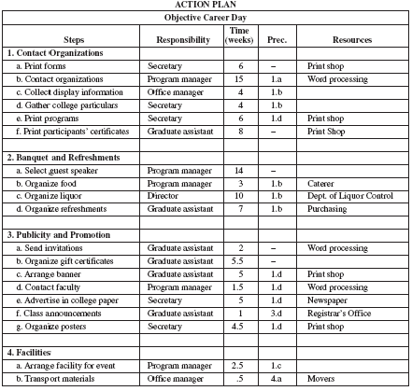
SPM
Project Planning
Developing project plans

Slide 9
SPM
Project Planning
Developing project plans
Milestone schedule(s)
The milestone schedule provides a summary-level estimated timeline for the life of the project by listing the milestones needed for the entire process of successfully carrying out the project.
It allows the project team leader to review and identify all of the significant and major project-related milestones that may exist in the entire course of a project.
It can be helpful in making sure that nothing falls behind schedule or gets out of focus entirely.
Project milestone schedules contain information such as:
  Major milestones (including start date, end date, status): A project milestone is a terminal element that indicates the completion/accomplishment of a phase or subphase (such as related to a goal, intention) e.g. project review meetings, procurement, testing.
  Deliverables (including start date, end date, status): A deliverable is a tangible or intangible object produced during the execution of a project e.g. software application, data items (such as report, article).

Slide 10
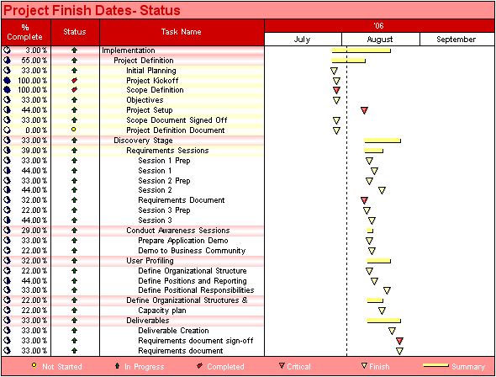
SPM
Project Planning
Developing project plans
Milestone schedule(s) (contd)
Example (in MS Project)

Slide 11
SPM
Project Planning
Developing project plans
Milestone schedule(s) (contd)
Note that data items are often overlooked.
Why is it important to pay attention to data items when preparing or using a milestone schedule?
  Skills: data items may require that staff with writing skills be assigned.
  Time: data items require direct-labour person-hours for writing, typing, proof-reading, editing, etc.

Slide 12
SPM
Project Planning
Hierarchical planning process
Hierarchical planning process
All activities required to complete a project must be precisely delineated, and coordinated. For instance (recall): some activities must be done sequentially, some simultaneously, some are critical, etc.
Using the hierarchical planning process/system can allow the activities to be identified and sorted appropriately.
What is hierarchical planning process? Hierarchical planning process, also known as the “even planning process”, is a planning approach that breaks the planning task down into the activities that must be done at each level.
Typically, the upper level sets the objectives for the next lower level.
  Begin with project’s objectives or goals.
  List major activities needed to achieve objectives (level 1 activities).
  Each major task is then broken down into more detail (ideally delegate level 1 activities to individuals/functional areas to develop list of level 2 activities, etc).
  The degree of detail should be same within a given level.
  This breakdown process continues until all activities to be completed are listed.
  In the process, it is important to know the task dependencies (sequential, simultaneous, etc).

Slide 13
SPM
Project Planning
Hierarchical planning process
Hierarchical planning process (contd)
Examples of hierarchical planning tools:
  Work Breakdown Structure (WBS) [recall]
  Linear Responsibility Chart (LRC)
  etc
Linear Responsibility Chart (LRC)
LRC, also referred to as Responsibility Assignment Matrix (RAM), describes the roles and responsibilities of project team members in completing tasks or deliverables for a project.

Slide 14
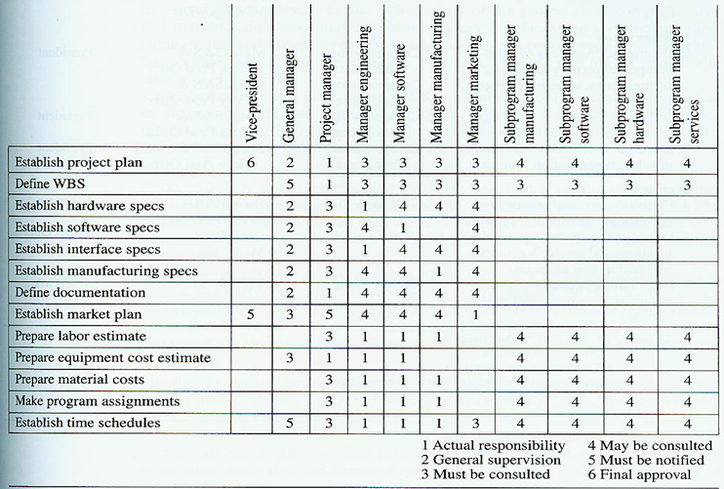
SPM
Project Planning
Hierarchical planning process
Hierarchical planning process (contd)
LRC
Example

Slide 15
SPM
Project Planning
Activity Planning
Introduction
Activity planning, sometimes referred to as scheduling, together with cost/financial planning are probably the major tools for the management of the project.
Activity planning will help to:
  Ensure that the appropriate resources will be available precisely when required.
  Avoid different activities competing for the same resource at the same time.
  Produce a detailed schedule showing when specific staff will be needed to carry out each particular activity.
  Produce a detailed plan against which actual achievement may be measured.
  Produce a timed forecast.
  Re-plan the project during its life to correct drift from a target.

Slide 16
SPM
Project Planning
Activity Planning
Methods for activity planning
Precedence analysis
Gantt charts
Network techniques (i.e. PERT / CPM)
  Activity-on-arrow networks
  Activity-on-node networks

Slide 17
SPM
Project Planning
Activity Planning
Precedence analysis
This analysis must be done before an activity plan can be produced.
It reviews the activities that are to be carried out.
It decides and indicates what activities must be carried out before a particular activity can start.

Slide 18
SPM
Project Planning
Activity Planning
Gantt charts
They were developed by Henry Gantt, around 1917.
A Gantt chart shows planned and actual progress for a number of tasks displayed against a horizontal time scale.
Advantages of Gantt charts:
  They are easy to produce/construct.
  Even though they may contain a great deal of information, they are easily understood.
  While they may require frequent updating, they are easy to maintain.
  Gantt charts provide a clear picture of the current state of a project.
They are very useful for use on less complex projects.
They do not represent well logical constraints.
They should be used to complement, not replace, network techniques.

Slide 19
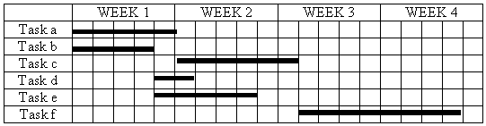
SPM
Project Planning
Activity Planning
Gantt charts (contd)
Draw a simple Gantt chart based on the following project data:
    Tasks Precedence Time
    a - 5 days
    b - 4 days
    c a 6 days
    d b 2 days
    e b 5 days
    f c,d 8 days

Slide 20
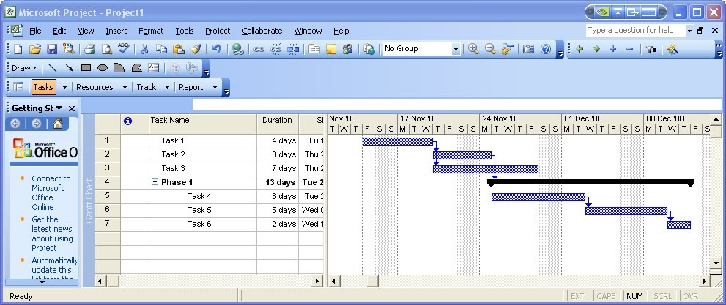
SPM
Project Planning
Activity Planning
Gantt charts (contd)
Example (MS Project)

Slide 21
SPM
Project Planning
Activity Planning
Network techniques
The basic approach entails forming a network of activity and event relationships.
The network should portray the sequential relations between the tasks in a project, in time as well as function.
Benefits of network techniques/approach:
  It is a consistent framework for planning and many other project aspects including monitoring and controlling.
  It illustrates the interdependence of all the project tasks.
  It denotes the times when specific individuals must be available for a given task.
  It aids in ensuring that the proper communications take place within the project and with the organization.
  It determines an expected project completion date.
  It identifies critical activities that, if delayed, will delay the project completion time.

Slide 22
SPM
Project Planning
Activity Planning
Network techniques (contd)
Benefits of network techniques/approach (contd):
  It identifies activities (with slack) that can be delayed for specific periods without delaying the project completion time.
  It determines the dates on which tasks may be started, or must be started if the project is to stay on schedule.
  It illustrates which tasks must be coordinated to avoid resource timing conflicts.
  It illustrates which tasks may be run, or must be run, in parallel to achieve the expected project completion date.
  It relieves some interpersonal conflict by clearly showing task dependencies.

Slide 23
SPM
Project Planning
Activity Planning
Network techniques (contd)
Examples of network techniques are PERT and CPM.
PERT (Program Evaluation and Review Technique)
It was developed by the US Navy with BOOZ-Allen Hamilton and Lockheed Corporation for the Polaris missile/submarine project in 1958.
CPM (Critical Path Method)
It is also known as CPA (Critical Path Analysis).
It was developed by DuPont Inc in the late 50s/early 60s to facilitate building of complex process plants.
Comparing PERT with CPM
PERT was developed for use on research & development projects; CPM was developed for use in construction projects.
When developed the two techniques were very similar.
Now there is virtually no difference between the two.

Slide 24
SPM
Project Planning
Activity Planning
Network techniques (contd)
Some terminology:
Activity - A specific task or set of tasks that are required by the project. Activities use up resources and take time to complete.
Event - The result of completing one or more activities. It is an identifiable end state occurring at a particular time. Events use no resources. Events are instances in time, points on the network, or conditions of a system that can be recognized.
Network - The combination of all activities and events. It defines the project and the activity precedence relationship. Arrow heads placed on the lines indicate the direction of flow. Before an event can be realized, all the activities that immediately precede it must be completed.
Path - The series of connected activities (or intermediate events) between events in a network.
Critical - Activities, events, or paths which, if delayed, will delay the completion of the project. A project’s critical path is the sequence of critical activities that connect the project’s start event to its finish event.

Slide 25
SPM
Project Planning
Activity Planning
Network techniques (contd)
An activity can be in any of these conditions:
  It may have a successor(s) but no predecessor(s) - starts a network.
  It may have a predecessor(s) but no successor(s) - ends a network.
  It may have both predecessor(s) and successor(s) - in the middle of a network.
The interconnections depend on the technological relationships described in the action plan (recall: what is to be done [activities], when it is to be done [schedules], who or what is needed [resources needed]).

Slide 26
SPM
Project Planning
Activity Planning
Network techniques (contd)
Network syntax:
  Time moves from left to right.
  Nodes are numbered sequentially.
  A network may not contain loops.
  Precedents are the immediate preceding activities.
  Dummy activities can be used to indicate a particular precedence.
Question: What are dummy activities?

Slide 27
SPM
Project Planning
Activity Planning
Network techniques (contd)
Network techniques comprise:
  Activity-on-Arrow (AOA) network models/diagrams
  Activity-on-Node (AON) network models/diagrams

Slide 28
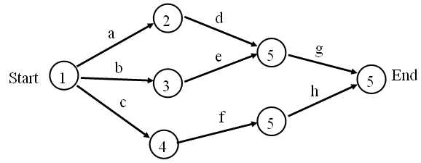
SPM
Project Planning
Activity Planning
Activity-On-Arrow (AOA) network models/diagrams
Activity-on-arrow (AOA) network models use arrows to represent activities while nodes represent events.
Here is a simple example of an activity-on-arrow network model/diagram.

Slide 29
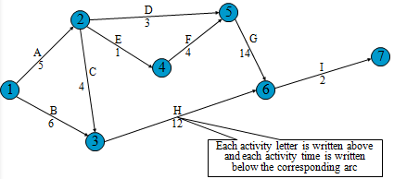
SPM
Project Planning
Activity Planning
Activity-On-Arrow (AOA) network models/diagrams (contd)
Activity-on-arrow (AOA) network with time
Note we will this example later
Question: Show the critical path

Slide 30
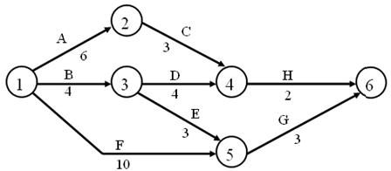
SPM
Project Planning
Activity Planning
Activity-On-Arrow (AOA) network models/diagrams (contd)
Given the following project data, draw an activity-on-arrow network.
    Tasks Precedence Time
    A - 6 weeks
    B - 4 weeks
    C A 3 weeks
    D B 4 weeks
    E B 3 weeks
    F - 10 weeks
    G E,F 3 weeks
    H C,D 2 weeks
Question: Show the critical path

Slide 31
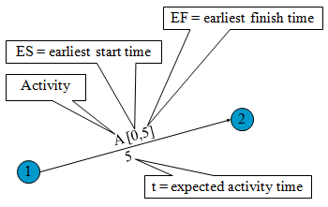
SPM
Project Planning
Activity Planning
Activity-On-Arrow (AOA) network models/diagrams (contd)
Earliest start (ES) time and earliest finish (EF) time

Slide 32
SPM
Project Planning
Activity Planning
Activity-On-Arrow (AOA) network models/diagrams (contd)
Earliest start (ES) time and earliest finish (EF) time (contd)
  First, find the critical path.
  Then do a forward pass calculation as follows:
    Starting at the network’s origin (node 1) and using a starting time of 0, we compute an earliest start (ES) and earliest finish (EF) time for each activity in the network.
    The expression EF = ES + t can be used to find the earliest finish time for a given activity, t is the expected time for the respective activity.
    For example, for activity A, ES = 0 and t = 5; thus the earliest finish time for activity A is
  EF = 0 + 5 = 5
  Note: Earliest start time rule: The earliest start time for an activity leaving a particular node is equal to the largest of the earliest finish times for all activities entering the node.

Slide 33
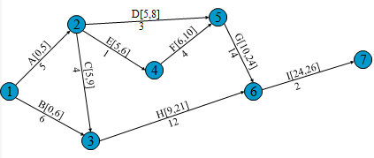
SPM
Project Planning
Activity Planning
Activity-On-Arrow (AOA) network models/diagrams (contd)
Earliest start (ES) time and earliest finish (EF) time (contd)
  Example

Slide 34
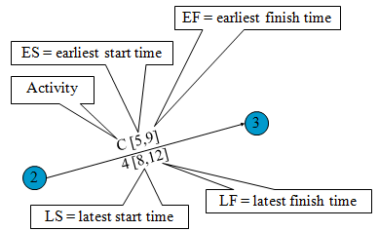
SPM
Project Planning
Activity Planning
Activity-On-Arrow (AOA) network models/diagrams (contd)
Latest start (LS) time and latest finish (LF) time

Slide 35
SPM
Project Planning
Activity Planning
Activity-On-Arrow (AOA) network models/diagrams (contd)
Latest start (LS) time and latest finish (LF) time (contd)
  First, find the critical path.
  Then do a backward pass calculation as follows:
    Starting at the completion point (node 7) and using a latest finish time (LF) of 26 for activity I, we trace back through the network computing a latest start (LS) and latest finish time for each activity.
    The expression LS = LF – t can be used to calculate latest start time for each activity.
    For example, for activity I, LF = 26 and t = 2, thus the latest start time for activity I is
    LS = 26 – 2 = 24
  Note: Latest finish time rule: The latest finish time for an activity entering a particular node is equal to the smallest of the latest start times for all activities leaving the node.

Slide 36
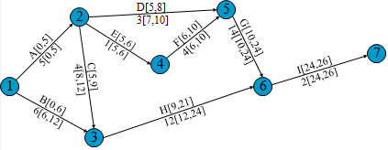
SPM
Project Planning
Activity Planning
Activity-On-Arrow (AOA) network models/diagrams (contd)
Latest start (LS) time and latest finish (LF) time (contd)
  Example

Slide 37
SPM
Project Planning
Activity Planning
Activity-On-Arrow (AOA) network models/diagrams (contd)
Slack
  This is sometimes referred to as float (or free time).
  Slack is the length of time an activity can be delayed without affecting the completion date for the entire project. This primarily applies to activities that are not on the critical path. The slack is zero for activities on the critical path.
  Slack = Latest start – Earliest start

Slide 38
SPM
Project Planning
Activity Planning
Activity-On-Arrow (AOA) network models/diagrams (contd)
Relevance of critical path and slack
  Slack shows how much allowance each activity has i.e. how long it can be delayed without affecting completion date of project.
  Note that the critical path is a sequence of activities from start to finish with zero slack.
  If any activity on the critical path is shortened or extended, project time will be shortened or extended accordingly. A lot of effort should thus be put in trying to control activities on the critical path, so that the project can be completed in the expected time.
    If there are resources that can speed up some activity, it is recommended to do so for critical activities as a priority.
    If resources can be saved by lengthening some activities, it is recommended to do so for non-critical activities, but up to the limit of slack.

Slide 39
SPM
Project Planning
Activity Planning
Activity-On-Node (AON) network models/diagrams
Activity-on-Node (AON) networks use nodes to represent activities with arrows to show precedence relationships.
The choice between AOA and AON representation is largely a matter of personal preference.
AON representation is becoming more common as it is used by many project planning software packages.
Syntax for AON networks is primarily the same as for AOA networks, except that AON networks do not allow dummy activities in their representation.

Slide 40
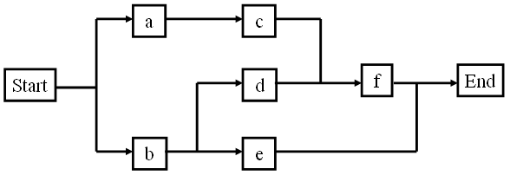
SPM
Project Planning
Activity Planning
Activity-On-Node (AON) network models/diagrams (contd)
Draw an activity-on-node network for the following project data:
  Tasks Precedence Time
  a - 5 days
  b - 4 days
  c a 6 days
  d b 2 days
  e b 5 days
  f c,d 8 days

Slide 41
SPM
Project Planning
Financial Planning
Introduction
Research indicates that IT projects have a poor track record for meeting budget goals; we therefore need to pay close attention to the budget goals in IT projects.
Cost is a resource sacrificed or foregone to achieve a specific objective or something given up in exchange. Costs are usually measured in monetary units.
Project cost management includes the processes required to ensure that the project is completed within an approved budget. Project cost management processes include:
  Resource planning: determining what resources (people, equipment, and materials) a project team should use to perform project activities and the quantities of each resource.
  Cost estimation: developing an approximation or estimate of the costs of the resources needed to complete a project.
  Cost budgeting: allocating the overall project cost estimate to individual work items to prepare budgetary estimates and to establish a cost baseline for measuring project performance.
  Cost control: controlling changes to the project budget.

Slide 42
SPM
Project Planning
Financial Planning
1. Resource planning
Resource planning involves determining what resources (people, equipment, and materials) a project team should use to perform project activities and the quantities of each resource.
The people who help determine what resources are necessary include people who have experience and expertise in similar projects and with the organization performing the project.

Slide 43
SPM
Project Planning
Financial Planning
2. Cost estimation
Cost estimation involves developing an approximation or estimate of the costs of the resources needed to complete a project.
Cost estimates must be taken seriously for projects to complete within budget constraints.
Types of cost estimates are:
  Rough order of magnitude (ROM) estimate;
  Budgetary estimate; and
  Definitive estimate
Question: Define the above types of cost estimates

Slide 44
SPM
Project Planning
Financial Planning
3. Cost budgeting
This involves allocating the overall project cost estimate to individual work items to prepare budgetary estimates and to establish a cost baseline for measuring project performance.
These work items are based on the WBS for the project.
An important goal of cost budgeting is to produce a cost baseline, which is a time-phased budget that project managers use to measure and monitor cost performance.
Examples of budget

Slide 45
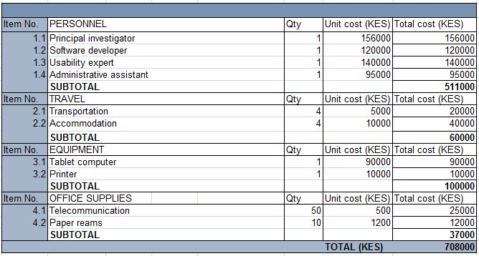
SPM
Project Planning
Financial Planning
3. Cost budgeting
Example: Budget for a website development project

Slide 46
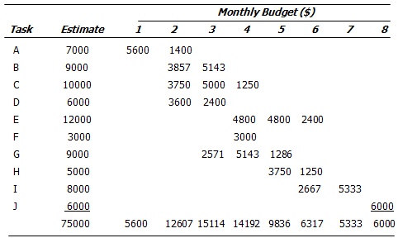
SPM
Project Planning
Financial Planning
3. Cost budgeting
Example of project budget (by task and month)

Slide 47
SPM
Project Planning
Financial Planning
4. Cost control
This involves controlling changes to the project budget.
Project cost control includes:
  Monitoring cost performance.
  Ensuring that only appropriate project changes are included in a revised cost baseline.
  Informing project stakeholders of changes to the project that will affect costs.
The cost control process realizes documents such as revised cost estimates, budget updates, corrective action, lessons learned, etc.

Slide 48
SPM
Project Planning
Financial Planning
Financial evaluation
Techniques such as the following ones are used:
Net profit: total income (or revenue) - total cost (or expenditure)
Payback period: time taken to break even
Return on investment (ROI): compares investment required with net profitability i.e. ROI= average annual profit / total investment x 100
Net present value (NPV):
  NPV discounts future cash flows to current money values, by using a percentage rate called the discount rate (or discount factor).
  The formula for discounted or future cash flows = value in year t / (1+r)^{t}, where r is the discount rate expressed as a decimal value and t is the number of years in the future
  Note NPV = (sum of all the discounted cash flows)
  Example (next slide)
  Question: Do we prefer NPV –ve, +ve, etc?
etc

Slide 49
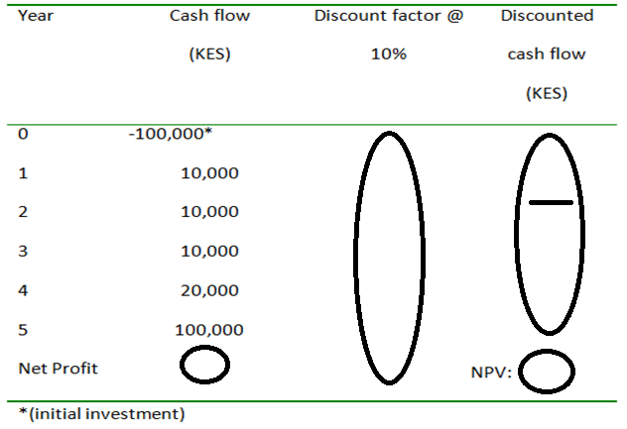
SPM
Project Planning
Financial Planning
Financial evaluation
NPV example?
e.g.10,000/(1+0.1)²

Slide 50
SPM
Project Planning
AOB
Any Questions?
Notes:
Introduction

